Slide 1
SPARK RPE65
AIDA VAN RIEL AND SANYA

Slide 2

WHO ARE WE?
GENE THERAPY PIONEER
(1)
CHILDREN'S HOSPITAL OF PHILADELPHIA
WHAT DOES GENE THERAPY DO?
Actually fixing the problem
OUR TEAM
Over 120 years of combined experience
CURRENT PROGRAMS
RPE65 ⟶ phase III
Hemophilia B ⟶ phase I/II

Slide 3
WHERE DO WE STAND FINANCIALLY?
Cash on hand
Burn rate
Runway
$ 73 million
$29 million/year
~ 2.5 years

Slide 4

THE COSTS AHEAD OF US
Commerical infrastructure
Scale up manufacturing
Phase III trial
$11-53 million
Gene trials are complex
$ ?
Sales team, marketing team, distribution network
$ ?
small ⟶ large quantities
(2)

Slide 5

THE MATH
$73 MILLION
$30 - 50 MILLION
$20 - 40 MILLION
SALES TEAM
CURRENT EXPENSES
MARKETING ORGANIZATION
COMMERCIAL MANUFACTURING

Slide 6
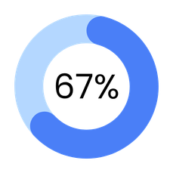
WHY DOES IT MATTER?
(3)
FAIL TO MEET EXPECTATIONS
(3)
COMPANY WAS NOT PREPARED ⟶ COMMERCIALIZE
EARLY 2000S ⟶ LOST CONFIDENCE
WE HAVE THE SCIENCE, WE HAVE THE TEAM, WE HAVE THE PRODUCT
We need the funding

Slide 7
PARNERSHIP WITH PFIZER?
GENE THERAPY SHOULD CURE
Hemophilia B results don't last (yet)
WHAT DOES THIS MEAN FOR US?
More research, more trials, more money, higher risk
PFIZER'S OFFER
  $20 million upfront
  Up to $260 million in milestone payments
  Royalties
  We lead through phase I/II, Pfizer phase III, approval and commercialization

Slide 8
WHY IS THIS THE RIGHT CHOICE?
  Risk transfer
  Hemophilia B fails
  Hemophilia B succeeds
  Credibility gain
  We are legitimate
  Non-dilutive funding
  Retainment of ownership
  increases FDA approval
(4)
  30% more likely

Slide 9

WHY IS THIS THE RIGHT CHOICE?
  Risk transfer
  Hemophilia B fails
  Hemophilia B succeeds
  Credibility gain
  We are legitimate
  Non-dilutive funding
  Retainment of ownership
  increases FDA approval
(4)
  30% more likely

Slide 10

WHY IS THIS THE RIGHT CHOICE?
  Risk transfer
  Hemophilia B fails
  Hemophilia B succeeds
  Credibility gain
  We are legitimate
  Non-dilutive funding
  Retainment of ownership
  increases FDA approval
(4)
  30% more likely
Why not develop it ourselves?
Why not take a better deal?

Slide 11



ACCEPT THE PFIZER PARTNERSHIP
GAIN FUNDING
GAIN CREDIBILITY
TRANSFER THE RISK

Slide 12
GOING PUBLIC: WHEN?
Spark is a private company:
  CHOP owns 53%
  Rest venture capital firms
Shares are not publically shared
Solution? Initial Public Offering
Trade-off: dilution
53% ⟶ 37%

Slide 13
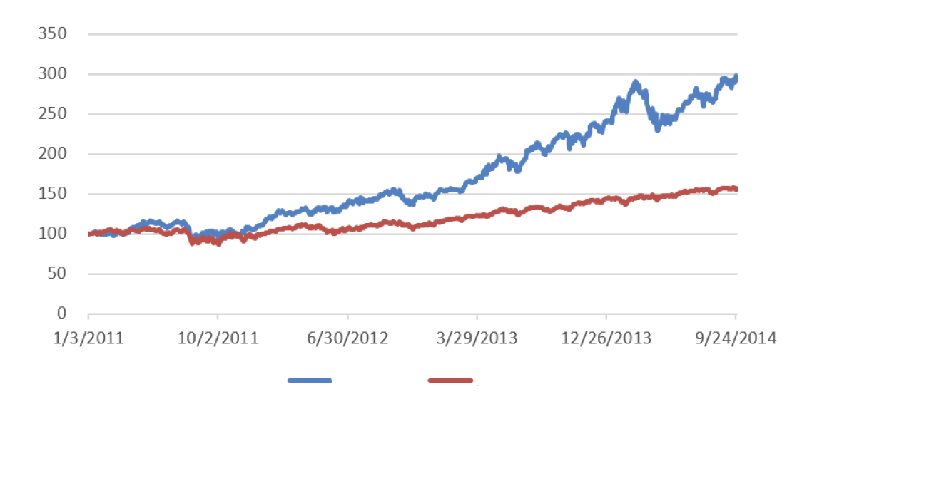
SHOULD WE WAIT?
  Higher valuation ⟶ dilution is lower
BUT....
  Market conditions don't wait for us
195% biotech index increase
  Raising $6 billion
(5)
56% broader market index increase

Slide 14

We have something rare
“We don't see many young companies who already have a product in Phase III"
We are ready
(6)
62% of CFOs at public biotech companies were first-time CFOs
Proceed with IPO,
after Pfizer partnership
$ 150 million from investment bankers
+
$ 20 million Pfizer
$ 170 million, runway for at least 5 years

Slide 15
FDA process
Good relationship FDA
  Play fair with them, they play fair with you
Breakthrough therapy designation
FDA request: add secondary primary endpoint
Gentle pushback. Why?
  Rare disease
  No other availiable treatments for condition
  Patients lose their only hope
We will find a solution together

Slide 16



COMPETITION
Biologics
  complex medicines
Viral vectors
  Few facilities can manufacture
Exclusive rights
  patents and licenses
WE WILL BE ESTABLISHED MARKET LEADER

Slide 17
COMPETITION
REGULATION
Biologics
Uncertain environment
BUT
  complex medicines
Viral vectors
Gently push back
  Rare disease
  High unmet need
  Ready for breakthrough
  Few facilities can manufacture
Exclusive rights
  patents and licenses
WE WILL BE ESTABLISHED MARKET LEADER

Slide 18

LATE 2014
Pfizer partnership
TIMELINE
EARLY 2015
IPO
SECOND HALF 2015
Phase III results
2016-2017
FDA approval
2017
Commercial launch

Slide 19


QUESTIONS AND DISCUSSIONS

Slide 20
SOURCES
  LogiPharma. Roche and Spark are Working Together to Boost Manufacturing Capacity [Internet]. LogiPharma EU. 2022 [cited 2026 Apr 13]. Available from: https://logipharmaeu.wbresearch.com/blog/roche-and-spark-are-working-together-to-boost-manufacturing-capacity
  Sertkaya A, Wong HH, Jessup A, Beleche T. Key cost drivers of pharmaceutical clinical trials in the United States. Clin Trials. 2016;13(2):117-126. doi:10.1177/1740774515625964. PMID: 26908540
  Guidehouse. Pre-commercial biotech: Critical steps to navigating R&D to market [Internet]. Guidehouse Insights. 2024 Aug [cited 2026 Apr 13]. Available from: https://guidehouse.com/insights/healthcare/2024/pre-commercial-biotech-navigating-to-market
  Nicholson S, Danzon PM, McCullough J. Biotech-pharmaceutical alliances as a signal of asset and firm quality. J Bus. 2005;78(4):1433-1464. Available from: https://pmc.ncbi.nlm.nih.gov/articles/PMC3564334/
  GlobalData. Global gene therapy deals sky-rocketed to nearly US$5bn in 2014 [Internet]. Manufacturing Chemist. 2015 Jun 26 [cited 2026 Apr 13]. Available from: https://www.manufacturingchemist.com/global-gene-therapy-deals-sky-rocketed-to-nearly-us-5bn-in-2014-109748
  Russell Reynolds Associates. Looking for Biotech CFOs in New Places [Internet]. Russell Reynolds Associates. 2019 Apr [cited 2026 Apr 13]. Available from: https://www.russellreynolds.com/en/insights/reports-surveys/looking-for-biotech-cfos-in-new-places
All other information is from the Spark Therapeutics: Pioneering Gene Therapy pdf file.

